Slide 1
Query/Scripting
Language
Graph
Processing
Machine
Learning
Streaming
Processing
Execution Engine
Database
Storage
Resource Manager

Slide 2
Pig/Hive
Giraph
Mahout
Hadoop MapReduce
HBase
HDFS
YARN

Slide 3
Shark
GraphX/Bagel
MLBase
D-Stream
Spark
HDFS
Mesos

Slide 4
Query/Scripting
Language
Graph
Processing
Machine
Learning
Streaming
Processing
Execution Engine
Database
Storage
Resource Manager

Slide 5
Query/Scripting
Language
Graph
Processing
Machine
Learning
Streaming
Processing
Execution Engine
Database
Storage
Resource Manager

Slide 6
Query/Scripting
Language
Graph
Processing
Machine
Learning
Streaming
Processing
Execution Engine
Database
Storage
Resource Manager

Slide 7
Query/Scripting
Language
Graph
Processing
Machine
Learning
Streaming
Processing
Execution Engine
Database
Storage
Resource Manager

Slide 8
Query/Scripting
Language
Graph
Processing
Machine
Learning
Streaming
Processing
Execution Engine
Database
Storage
Resource Manager

Slide 9
Query/Scripting
Language
Graph
Processing
Machine
Learning
Streaming
Processing
Execution Engine
Database
Storage
Resource Manager

Slide 10
Query/Scripting
Language
Graph
Processing
Machine
Learning
Streaming
Processing
Execution Engine
Database
Storage
Resource Manager

Slide 11
Query/Scripting
Language
Graph
Processing
Machine
Learning
Streaming
Processing
Execution Engine
Database
Storage
Resource Manager

Slide 12
DBMS
Query
Results
Index
Data

Slide 13
SPS
Stream
Results
Data
Queries

Slide 14
Pig, Hive, Shark
FlumeJava, SCOPE
DryadLINQ, PACT
Pregel, GraphLab
Bagel, Giraph
Mahout, MLBase
SystemML, Presto
Sorme, S4, SEEP
Dstream, Naiad
MapReduce, Dryad, Spark, Nephele, Hayracks
BigTable, Hbase, Dynamo, Cassandra
MongoDB, Voldemort
HDFS, S3
YARN, Mesos

Slide 15
Streaming
Processing
Query/Scripting
Language
Machine
Learning
Graph
Processing
Execution Engine
Database
Storage
Resource Manager

Slide 16
Pig/Hive
Mahout
Pregel
MapReduce
HBase
HDFS
YARN

Slide 17
D-Stream
Shark
MLBase
GraphX
Bagel
Spark
HBase
HDFS
Mesos

Slide 18
Streaming
Processing
Query/Scripting
Language
Machine
Learning
Graph
Processing
Execution Engine
Database
Storage
Resource Manager

Slide 19
Streaming
Processing
Query/Scripting
Language
Machine
Learning
Graph
Processing
Execution Engine
Database
Storage
Resource Manager

Slide 20
Streaming
Processing
Query/Scripting
Language
Machine
Learning
Graph
Processing
Execution Engine
Database
Storage
Resource Manager

Slide 21
Streaming
Processing
Query/Scripting
Language
Machine
Learning
Graph
Processing
Execution Engine
Database
Storage
Resource Manager

Slide 22
Streaming
Processing
Query/Scripting
Language
Machine
Learning
Graph
Processing
Execution Engine
Database
Storage
Resource Manager

Slide 23
Streaming
Processing
Query/Scripting
Language
Machine
Learning
Graph
Processing
Execution Engine
Database
Storage
Resource Manager

Slide 24
Streaming
Processing
Query/Scripting
Language
Machine
Learning
Graph
Processing
Execution Engine
Database
Storage
Resource Manager

Slide 25
Streaming
Processing
Query/Scripting
Language
Machine
Learning
Graph
Processing
Execution Engine
Database
Storage
Resource Manager

Slide 26
Sorme, S4, SEEP
Dstream, Naiad
Pig, Hive, Shark
FlumeJava, SCOPE
DryadLINQ, PACT
Mahout, MLBase
SystemML, Presto
Pregel, GraphLab
Bagel, Giraph
MapReduce, Dryad, Spark
Nephele, Hayracks
BigTable, Hbase, Dynamo
Cassandra, MongoDB, Voldemort
HDFS, S3
Mesos, YARN

Slide 27
Shared nothing
Shared disk
Shared memory
Interconnect
Interconnect
Interconnect
Process
Memory
Disk

Slide 28
Map
Shuffle
Reduce

Slide 29
Client
Job
Job
Tracker
Name
Node
Task
Tracker
Task
Task
Tracker
Task
Task
Tracker
Task
Task
Task
Task
Data
Node
Data
Node
Data
Node
Task
Task
Task
Server
MapReduce
HDFS

Slide 30
HDFS
Read
HDFS
Write
HDFS
Read
HDFS
Write
HDFS
Read
Iter. 1
Iter. 2
...
Input
Query 1
Results1
Query 2
Results1
Input
Query 3
Results1

Slide 31
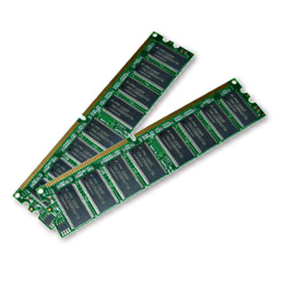
Iter. 1
Iter. 2
...
Input
Query 1
Results1
Query 2
Results1
Input
Query 3
Results1

Slide 32

Worker
RAM
Driver
tasks
results
Worker
RAM
Worker
RAM

Slide 33
file:
HDFS Text File
path = hdfs://...
sics:
Filtered Dataset
func = _.contains(...)
cachedSics:
Cached Dataset
ones:
Mapped Dataset
func = _ => 1

Slide 34
map, filter
join with inputs
co-partitioned
union

Slide 35
groupByKey
Join with inputs not
co-partitioned

Slide 36
A
B
stage1
G
groupBy
C
D
F
map
E
join
stage2
union
stage3

Slide 37
Your application
SparkContext
Cluster
Manager
Local
Threads
Worker
Worker
Spark
Executor
Spark
Executor
HDFS or other storage

Slide 38
M
C
R
R
M
M
client
Cloud controller
JM
TM
TM
TM
M
R
M
R
J
R
M
Hadoop
Stratosphere

Slide 39
Input 1
Task: lineReaderTask
Input: s3://user:key@storage/inpput
Task 1
Task: myTask
Output 1
Task: lineWriterTask
Output: s3://user:key@storage/output
Stage 1
Execution stage
Output 1 (1)
Id: …
Type: m1.large
Stage 0
Execution instance
Task 1 (2)
Group vertex
Input 1 (1)
Id: …
Type: m1.small
Execution vertex

Slide 40
“foo”
“bar”
“sics”
“kth”
“a”
“b”
“c”
(1, “foo bar”)
(2, “sics kth”)
(3, “a b c”)
flatMap { … }
(“green”, 15)
(“blue”, 5)
(“brown”, 22)
(“blue”, 16)
(“green”, 2)
(“green”, 2)
(“blue”, 5)
(“brown”, 22)
groupBy { … }
.reduceGroup { ...}

Slide 41
(“foo”, 1)
(“kth”, 2)
(“black”, 3)
(2, “sics”)
(3, “white”)
(1, “bar”)
(3, “red”)
join
“foo and bar”
“kth and sics”
“black and white”
“black and red”

Slide 42
Table
Column
Row
Database

Slide 43
Command-line shell
Thrift/JDBC
Metastore
Driver
SQL Parser
Query
Optimizer
Physical Plan
SerDes, UDFs
Execution
MapReduce
RDBMS (MySQL)
Hadoop Storage (HDFS, HBase)

Slide 44
Command-line shell
Thrift/JDBC
Metastore
Driver
SQL Parser
Query
Optimizer
Physical Plan
SerDes, UDFs
Execution
Spark
RDBMS (MySQL)
Hadoop Storage (HDFS, HBase)

Slide 45
1
John
4.1
1
2
3
2
mike
3.5
john
mike
sally
3
sally
6.4
4.1
3.5
6.4
Row Storage
Column Storage

Slide 46
Streaming
Processing
Query/Scripting
Language
Machine
Learning
Graph
Processing
Execution Engine
Resource Management
Storage
Database

Slide 47
Streaming
Processing
Query/Scripting
Language
Machine
Learning
Graph
Processing
Execution Engine
Resource Manager
Storage
Database

Slide 48
Streaming
Processing
Query/Scripting
Language
Machine
Learning
Graph
Processing
Execution Engine
Resource Manager
Storage
Database

Slide 49
Streaming
Processing
Query/Scripting
Language
Machine
Learning
Graph
Processing
Execution Engine
Resource Manager
Storage
Database

Slide 50
Streaming
Processing
Query/Scripting
Language
Machine
Learning
Graph
Processing
Execution Engine
Resource Manager
Storage
Database

Slide 51
Streaming
Processing
Query/Scripting
Language
Machine
Learning
Graph
Processing
Execution Engine
Resource Manager
Storage
Database

Slide 52
Streaming
Processing
Query/Scripting
Language
Machine
Learning
Graph
Processing
Execution Engine
Resource Manager
Storage
Database

Slide 53
Streaming
Processing
Query/Scripting
Language
Machine
Learning
Graph
Processing
Execution Engine
Resource Manager
Storage
Database

Slide 54
Streaming
Processing
Query/Scripting
Language
Machine
Learning
Graph
Processing
Execution Engine
Resource Manager
Storage
Database

Slide 55
Storm, S4, SEEP
Dstream, Naiad
Pig, Hive, Shark
Meteor, SCOPE
DryadLINQ
Mahout, MLBase
SystemML, Presto
Pregel, GraphLab
Bagel, GraphX
Giraph
MapReduce, Dryad, Spark
Nephele/PACT, Hayracks
Mesos, YARN
BigTable, Hbase, Dynamo
Cassandra, MongoDB, Voldemort
HDFS

Slide 56
?
Pig/Hive
Mahout
Giraph
MapReduce
YARN
HDFS
HBase

Slide 57
Nephele
Streaming
Meteor
?
Spargel
Nephele/PACT
YARN
HDFS
HBase

Slide 58
DStream
Shark
MLBase
GraphX
Spark
Mesos, YARN
HDFS
HBase

Slide 59
Nephele
Streaming
Meteor
?
Spargel
Nephele/PACT
YARN
HDFS
HBase

Slide 60
DStream
Shark
MLBase
GraphX
Spark
Mesos, YARN
HDFS
HBase

Slide 61
?
Pig/Hive
Mahout
Giraph
MapReduce
YARN
HDFS
HBase

Slide 62
PE1
PE2
PE1
PE1
PE2
PE1
PE2
PE1
PE
PE
PE
PE
PE
PE
PE

Slide 63
Information
flows
Information
flows
Information Flow
Processing Engine
Sources
Processing
Rules
Sinks
Rule mangers

Slide 64
Mutable state
Input records
node1
node3
Input records
node2
Input
node1
node3
Input
node1
Input
node2
node3
Input
node2
standby
synchronization
node1'
node3'
node2'

Slide 65

Twitter streaming API
batch @ t
batch @ t+1
batch @ t+2
tweets DStream
Stored in memory as an RDD
(immutable, distributed)
Twitter streaming API
batch @ t
batch @ t+1
batch @ t+2
tweets DStream
flatMap
flatMap
flatMap
New RDDs created for
every batch
hashTags Dstream
[#cat, #dog, …]

Slide 66

Twitter streaming API
batch @ t
batch @ t+1
batch @ t+2
tweets DStream
flatMap
flatMap
flatMap
hashTags Dstream
[#cat, #dog, …]
Every batch saved
to HDFS
save
save
save

Slide 67
Live data stream
Spark
Streaming
Batches of X seconds
Spark
Processed results

Slide 68
words
freqs
freqs_60s
words
freqs
freqs_60s
t-1
t-1
t
t
t+1
t+1
t+2
t+2
t+3
t+3
-
+
+
t+3
t+3
+

Slide 69
words
ones
freqs
tweets
DStream
Input data
replicated
in memory
Time = 0 - 1
map
reduce
Time = 1 - 2
map
reduce
Time = 2 - 3
map
reduce
flatMap
hashTags
Dstream
Lost partitions
recomputed on
other workers
words
ones
freqs
Time = 0 - 1
map
reduce
freqs_60s
Time = 1 - 2
map
reduce
window
reduce
Time = 2 - 3
map
reduce
window
reduce

Slide 70
Machine
Learning
Distributed
(cluster)
Centralized
(single machine)
Batch
Stream
Batch
Stream
Mahout
MLBase
SAMOA?
Weka
R
MOA

Slide 71
Storm, S4, SEEP
Dstream, Naiad
Pig, Hive, Shark
Meteor, SCOPE
DryadLINQ
Mahout, MLBase
SystemML, Presto
Pregel, GraphLab
Bagel, GraphX
Giraph, Spargel
PowerGraph
MapReduce, Dryad, Spark
Nephele/PACT, Hayracks
Mesos, YARN
BigTable, Hbase, Dynamo
Cassandra, MongoDB, Voldemort
HDFS

Slide 72


Barrier
compute
communicate

Slide 73
Vote to halt
Active
Inactive
Message received

Slide 74
3
6
2
1
Super step 0
3
6
2
1
Super step 0
6
6
2
6
Super step 1

Slide 75
3
6
2
1
Super step 0
6
6
2
6
Super step 1
6
6
6
6
Super step 2

Slide 76
3
6
2
1
Super step 0
6
6
2
6
Super step 1
6
6
6
6
Super step 2
6
6
6
6
Super step 3

Slide 77
vertex
consistency
data
data
data
data
data
data
data
data
data
data
data
data
data
edge consistency
full consistency

Slide 78
cpu2
cpu1

Slide 79
cpu2
cpu1

Slide 80
worker1
worker2
combiner
combiner
worker3
combiner

Slide 81
Management node
Management node
Secondry
Namenode
Namenode
Datanode
Datanode
...
Datanode
Node 1
Node 2
Node n

Slide 82
Namenode
Namenode
Namenode
Blocks Pools
Pool 1
Pool k
Pool N
Datanode
Datanode
...
Datanode
Node 1
Node 2
Node n

Slide 83
Namenode
Test.txt file = Block #1 (B1) + Block #2 (B2)
Datanode
Datanode
Datanode
Datanode
Datanode
B1
B2
B1
B2
B2
B1
Rack 1
Rack n

Slide 84
Client
1
Namenode
7
2
Datanode
3
Datanode
4
Datanode
6
5

Slide 85
Client
1
Namenode
2
3
Datanode
Datanode
Datanode

Slide 86
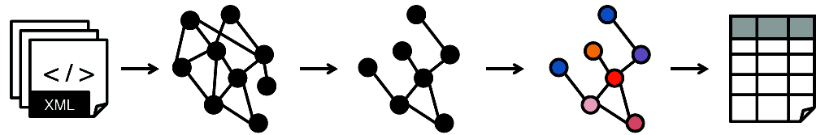



HDFS
HDFS
HDFS
HDFS

Slide 87
iterate
M
R
J
R
M
R
M
Driver
1st iteration
n^{st} iteration
2st iteration
M
R
M
R
M
R

Slide 88
inode
File Info
Data
Data
Direct
Blocks
Data
Data
Data
Indirect Blocks
Data
Double Indirect
Data
Triple Indirect
Data

Slide 89
15
0
1
14
Ahmad
2
Jim
13
3
12
Fatemeh
Sverker
4
11
5
10
Seif
6
9
8
7

Slide 90
Seif
15
0
1
Fatemeh
14
Fatemeh
Jim
Jim
2
Ahmad
13
3
12
4
Sverker
Ahmad
11
Seif
5
10
6
Sverker
9
8
7

Slide 91
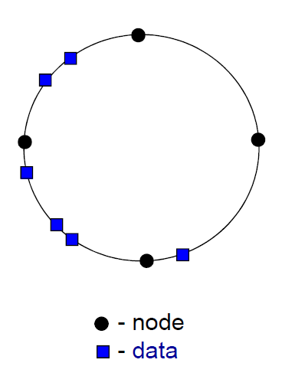
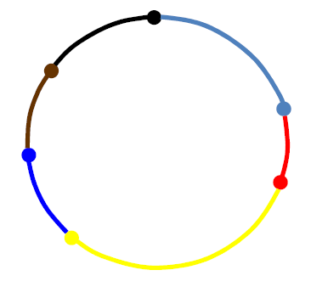

Slide 92
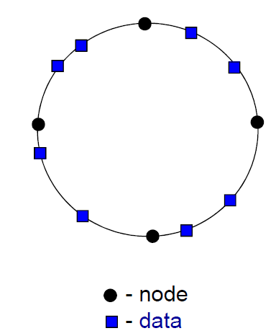
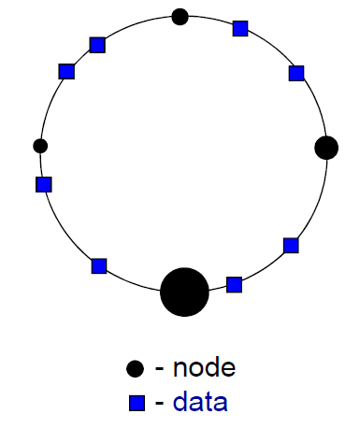
jim.mp3
fatemeh.mp3
tallat.mp3
seif.mp3
adele.mp3

Slide 93
